Slide 1
American and British holidays
What is your favourite holiday?

Slide 2
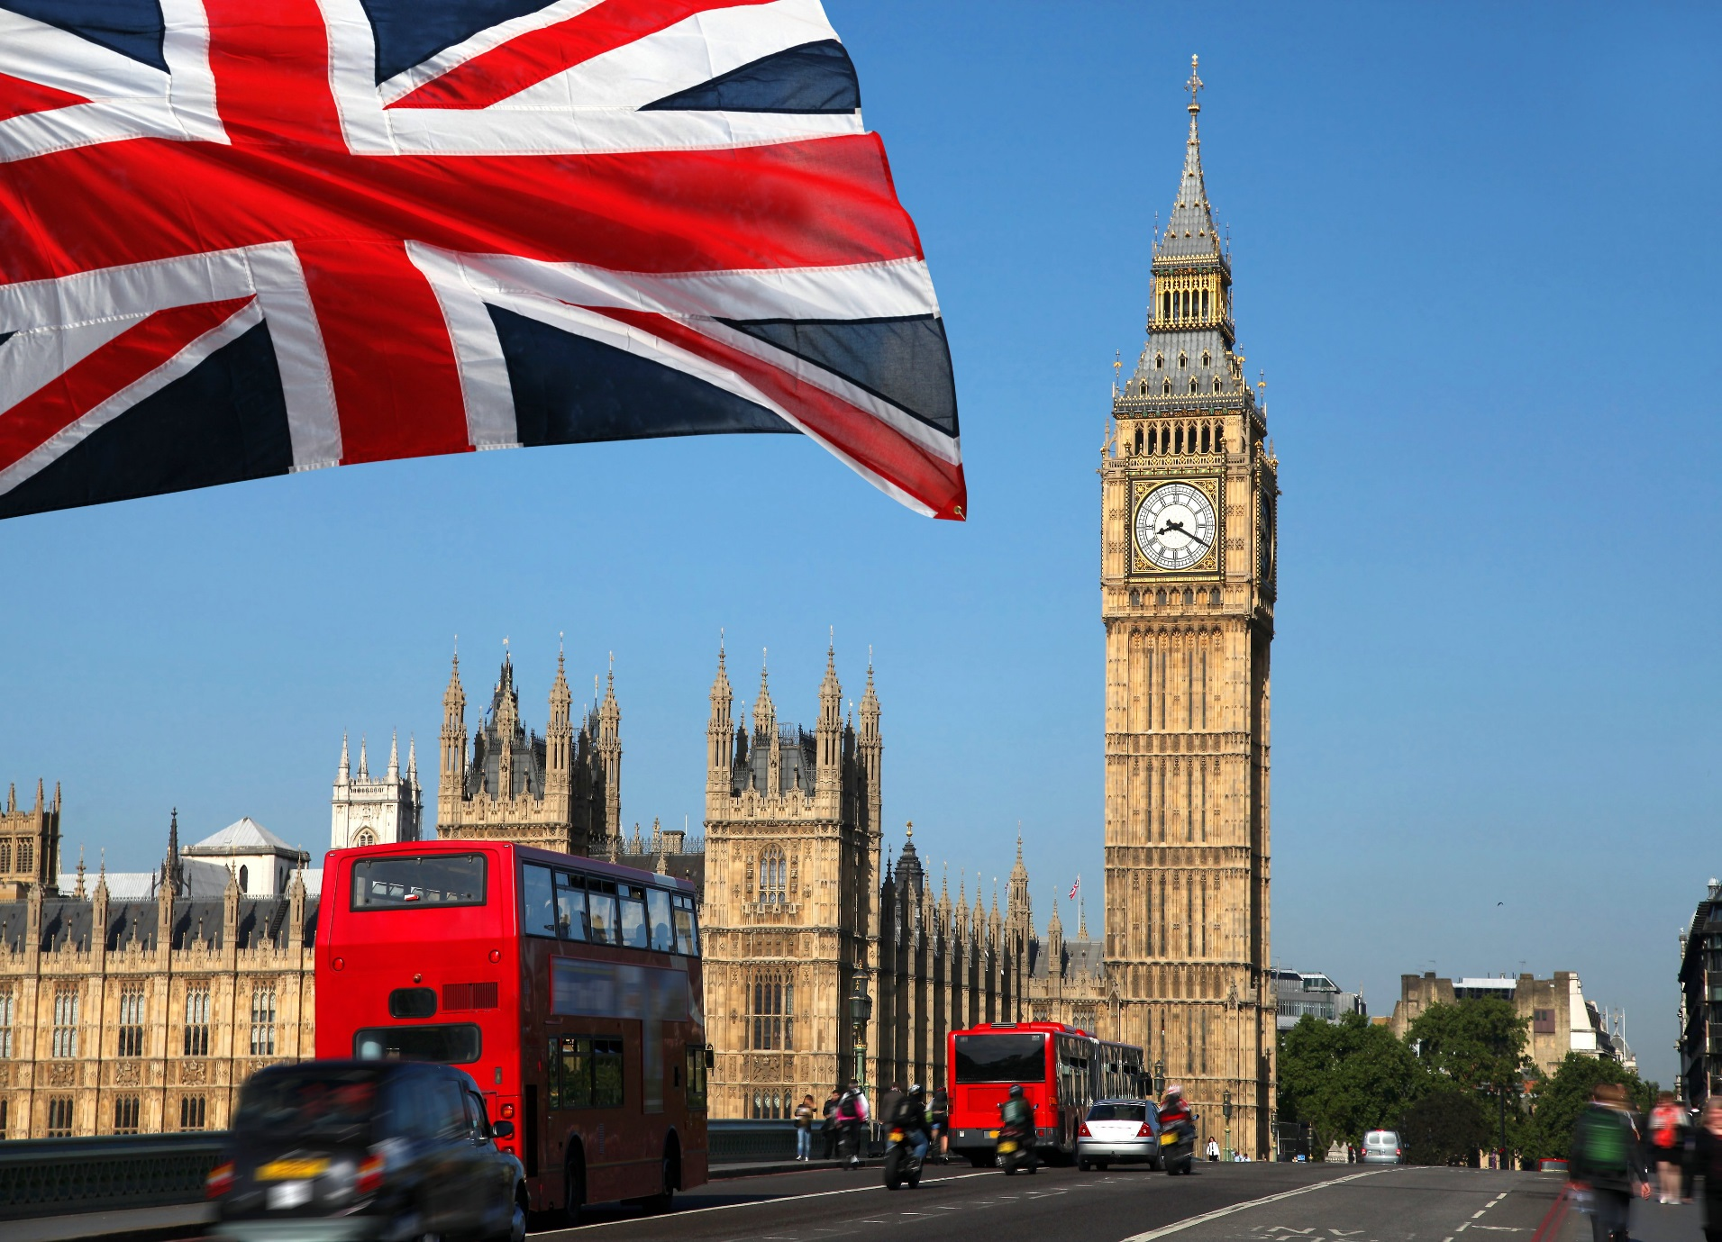

Slide 3

It is the most popular holiday in Britain. People choose and buy gifts, cook traditional dishes, decorate garden trees with electric lights, hang greeting cards on the walls and hang stockings on the beds.
Thanksgiving
day
Christmas
Chinese
New Year
Independence
Day
Easter
Halloween
Правильно!

Slide 4
People in bright costumes take part in Fun Parade. They dance, sing songs, light fireworks, watch parades. It is very interesting.
Thanksgiving
Day
Chinese
New Year
Independence
day
Easter
Halloween
Правильно!

Slide 5
This holiday is in spring. Everything is green in the countryside. It is really beautiful. People cook traditional food, colour eggs, eat cakes, gather together. Parents give their children chocolate bunnies.
Thanksgiving
Day
Independence
Day
Easter
Halloween
Правильно!

Slide 6
Americans have a big party on this day. This holiday is on the 4th of July. People raise the flag, light fireworks, cook traditional dishes, gather together, make pudding, watch parades and have parties.
Thanksgiving
Day
Independence
Day
Halloween
Правильно!

Slide 7
This holiday is on the fourth Thursday of November. Americans started to celebrate it in 1621. All people in the family gather in the house of their parents and eat a large traditional dinner.
Thanksgiving
Day
Halloween
Правильно!

Slide 8
It is very popular holiday in America and Britain. Children like it a lot. It is celebrated on the 31st of October. People wear fancy dresses, go house to house and do tricks.
Halloween
Правильно!

